Slide 1
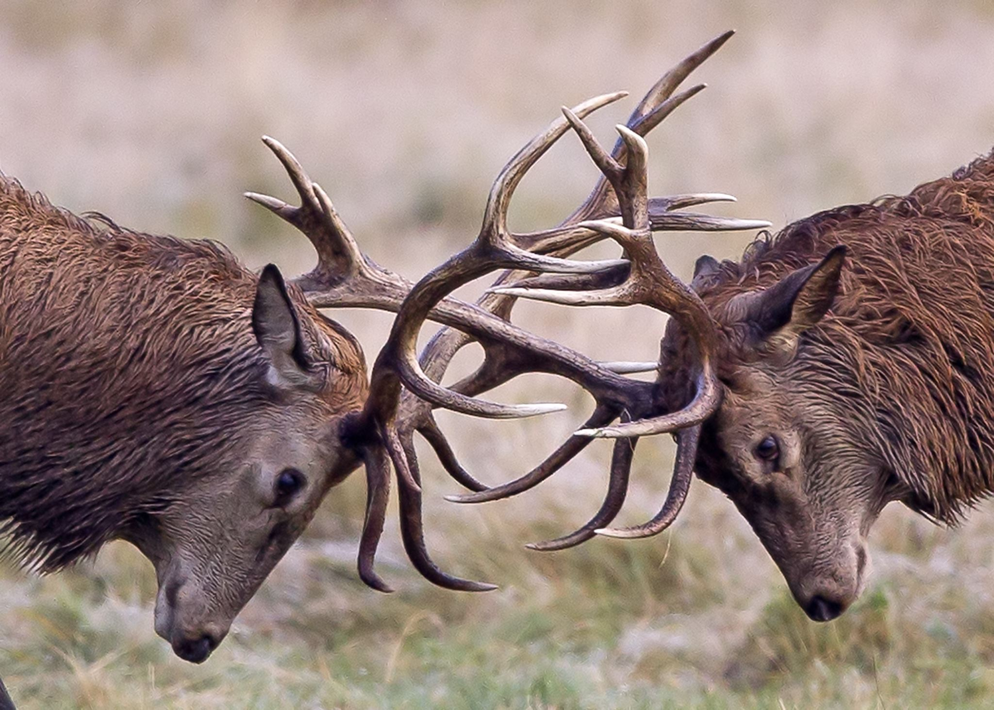
Dealing with Conflict and Maintaining Faculty (and Staff) Morale – and Your Own
Nancy A. Stanlick, Ph.D., Professor of Philosophy and Associate Dean
Incoming Chair, Department of Philosophy (on August 8, 2023 – 64 days from now)
College of Arts and Humanities
University of Central Florida
Institute for Academic Leadership, June 2023
Note: Many of the references and explanations of concepts and arguments presented here are derived from
professional experience in faculty, staff, and student grievances and complaints;
assisting Chairs and Directors with disciplinary and non-disciplinary matters and letters; and
mediating or settling disputes, where applicable – and where possible. Unfortunately, sometimes it doesn't work.
References to publications/sources are noted as appropriate.
MS365 Stock Photo

Slide 2
The Who, What, When, Where, How, and Why of Conflict

Slide 3
Question: Among Whom, When, and Where Does Conflict Occur? Duh. Answer: Everybody and Anybody, Anytime, and Anywhere
The Who, The When, and The Where

Slide 4
2. The "How" of Conflict and its Manifestations
Verbal or Written | Physical | Even more insidious
Raised voices | Slamming fists on tables | Veiled or explicit threats against a person’s professional standing
Gossip | Threats or perceived threats of physical violence | Creating factions for power plays
False Reporting; accusations; threats of legal or union action | Belief of one or more parties that physical violence will ensue | Promising or implying benefits to those who side with another person
Disruptions during meetings | When others feel uncomfortable in another person's mere presence | Using title or place in a hierarchy as an explicit or implicit threat
Testy, grumpy, unpleasant emails
MS365 Stock Photo

Slide 5
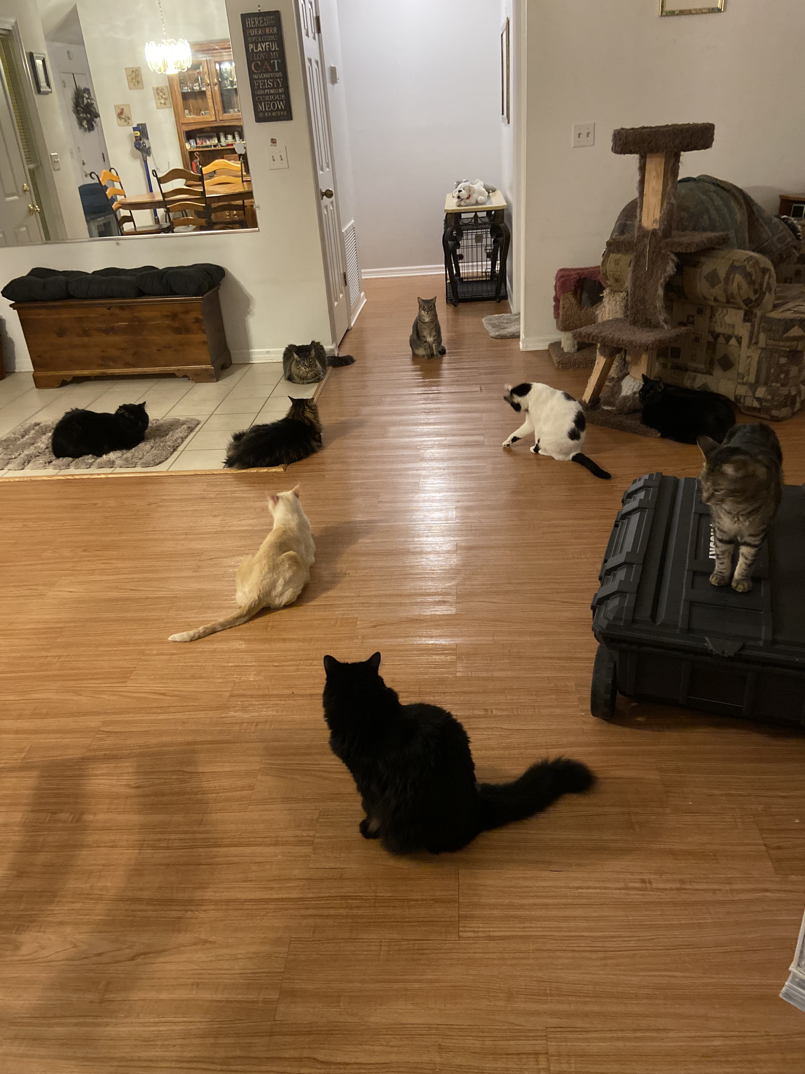
Is This Your Department Meeting? Faculty Cats in Conflict
A Brief Interlude....
The parliamentarian faculty cat who doesn't listen well, but who expects everyone else to do so
The too-good-for-this-meeting faculty cat. She's too important for all this
The faculty cats who annoy everybody
The tired, sleepy faculty cat
The Chair cat who prepares carefully. She is very brave in leading this group
The Assistant or Associate Chair cat and their plans
The competitive faculty cats having hissy fits. The Chair must respond! Disciplinary letters!
The almost always absent faculty cats
Just a little humor. It helps.

Slide 6
3. The Why: Causes of Conflict*
Competition: for gain
Diffidence: for defense
Glory: for reputation
*These are Thomas Hobbes’s “Causes of Quarrel” from Leviathan, Ch. 13, 1651.

Slide 7
Sources of Conflict in Competition: It's About Gain (Some Examples)
Curricular decisions – e.g., a course proposal is rejected
Winning (or not winning) awards
Getting (or not getting) promoted
Agreeing (or not) with university or college administration
Not liking someone's "attitude"
Speaking disparagingly about or toward others
Gossiping
And you name it.

Slide 8
The Sources of Conflict in Diffidence/Distrust and Self-Protection
Some Examples
Perceptions of professional inadequacy ("I'm not good at this.")
Misperceptions of professional adequacy ("You really aren't good at this.")
Resentment of hierarchy ("I ought to have that job. I work hard.")
Worry over contingent positions ("Am I going to have a job next year?")
Lying or misrepresenting facts for self-protection
Clashes of deeply held convictions ("Why don't you think the way I do???")
Coming to work: "Do we really need to be on campus? After all, we can do meetings and classes by Zoom and Teams!"
And a host of other sources such as:
Perceived pay disparities
Perception of differential treatment
Lack of understanding or acceptance of rules, policies, regulations, and laws

Slide 9
The Source of Conflict from Glory/Reputation
It's about our sense of self and the perception of our selves by others
Professional Progress: "Those people voted against me for promotion and tenure??? They're delusional."
Award Applications: "I should have received that award, not you. I want my application re-reviewed."
Behavior Gone Awry: "How dare they issue a letter of reprimand to me!"
Perception of Disrespect: "They don't like me and they don't respect me. That's why my course proposal was rejected."
Gossip: "Did you hear that thing about Joe?"
Competing for a Position: "Oh, yeah, he's everybody's favorite. That's why he got the job and I didn't."
Pay Disparities: "Why does she make more money than I get for the same job?"

Slide 10
4. The What (to do): Managing Conflict as Chair/Director
What is your take on contacting someone for help with managing conflict?
Does it make you seem ineffective if you ask for help?
Does it make you seem incompetent?
Does it make you seem that you have lost control of your unit?
THE ANSWER IS "NO" TO ALL OF THESE. We're in this together. When in doubt, ask for help. If you haven't "been there and done that," someone else has. And even if you have been there and done that, every case is a bit different from every other.

Slide 11
Managing Conflict: It’s the Most Fun You Can Have Without Laughing
Take care of yourself and your department.
You can't always do this alone, especially as a new chair or director. And even as an "old" chair or director – or as an old associate dean....
Where to Seek Assistance if You Can't Deal with it Yourself:
Other Chairs/Directors or Dean(s)
Contract Compliance Office
Avoiding Conflict -- and What if it Won't Stop?
Maintain clear and regular communication
You can't fix everything. Sometimes, you have simply to move on.
And sometimes, conflict can be productive.
"Resolving conflict isn’t about figuring out who is right and who is wrong. It’s about making the department better" (George Justice, "Managing Conflict as a Department Chair," Chronicle of Higher Education, May 13, 2021).

Slide 12
The Benefits of Conflict
If Federalist 10 (James Madison) might be a rough guide, "factions" can create problems, but they can also be beneficial:
Snuff out factions, and limit liberty (academic freedom)
Control effects of factions, which is impossible and undesirable
Managing Conflict with Benefits
Encourage, model, and promote civility, honor, disagreement, toleration, compromise, cooperation*
Ensure that all "factions" have equal or equitable opportunity to make their voices heard
A strong but neutral leader and good organizational structure can keep factions at bay without silencing them
Different ideas tend under the best circumstances to lead to better ideas and practices.
AND
J.S. Mill, On Liberty, Ch. 2: Silencing Ideas and Disagreements is a Bad Idea
True, and lose it
False, and no chance to defeat it
Combination, and still lose both benefits
Absolutely true, or accepted, and turns to dogmatism and lack of opportunity
*See C.K. Gunsalus, et al., "Challenged Academic Units," Inside Higher Education, Apr 25, 2018.
"When you are a unit’s leader, consciously model the ways in which you wish for others to treat you and each other, as well."

Slide 13
Ending Conflict
By solving the problem
Gaining and maintaining the trust of those who report to you
Addressing obstreperous behavior when it occurs
Mediating by listening to those experiencing conflict
Talking to your direct reports individually at least once or twice a year regarding their progress, concerns, and plans
Make sure they know they matter to you
Make sure YOU and THEY know that YOU matter, too
By recognizing that it can't be solved; but you can move on and it can often be minimized
Letters of counsel, instruction, reprimand
Noting in annual evaluations how conflict has affected adversely the performance of a person in that person's position (teaching, admin support, etc.)
Referring employees to an Employee Assistance Program
Appropriately monitoring behavior consistent with CBA requirements. READ THE CBA.

Slide 14
Improving and Maintaining Morale: Common Sense
Recognize achievements
Participate in unit activities
Create and maintain a unit culture of respect for support staff
Follow through on your promises and commitments
Encourage and model civil discussion and cooperation
It may reduce or eliminate competition, distrust, and perceptions of disrespect
React to incivility and lack of cooperation by addressing it appropriately where and when it occurs
In department meetings, individually, and between disputing parties
Perhaps most of all, morale is improved and maintained when conflict is managed well, minimized, and even sometimes optimized by using its benefits for the good of the unit.

Slide 15
Give Yourself a Break: Your Morale Counts, Too (This is Important Advice).
Take my advice. I should take it, too.
You are not chair, director, department head all the time. Go home and hug somebody, or your cat.
Have a friend you trust who understands you & what you do and with whom you can confidently and confidentially express yourself.
Thank that friend. Thank them more by being there and listening to them, too.
Ask for help when you need it.
Make friends with other chairs and directors. They know lots of stuff.
Take time for lunch. Get out of your office at least once a day.
Laugh at yourself.
Take an annual leave day or two every now and then and a real vacation at least once a year.

